Slide 1
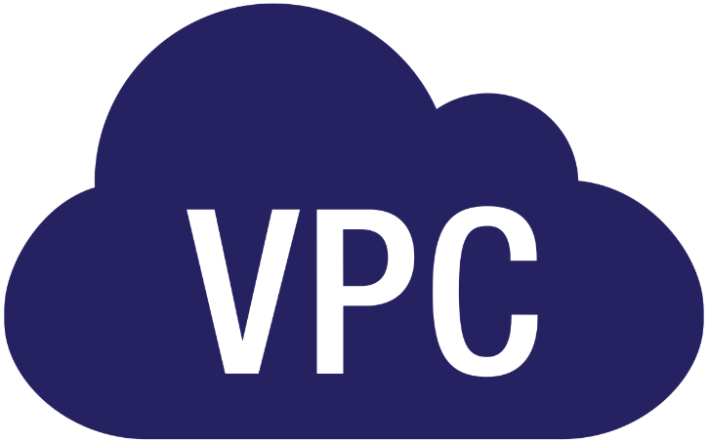

Slide 2

Topics
New VPC
Add subnet to New VPC
VPC
NAT Instance
NAT Gateway
NACL
Flow Logs
Bastion Host
VPC EndPoint

Slide 3
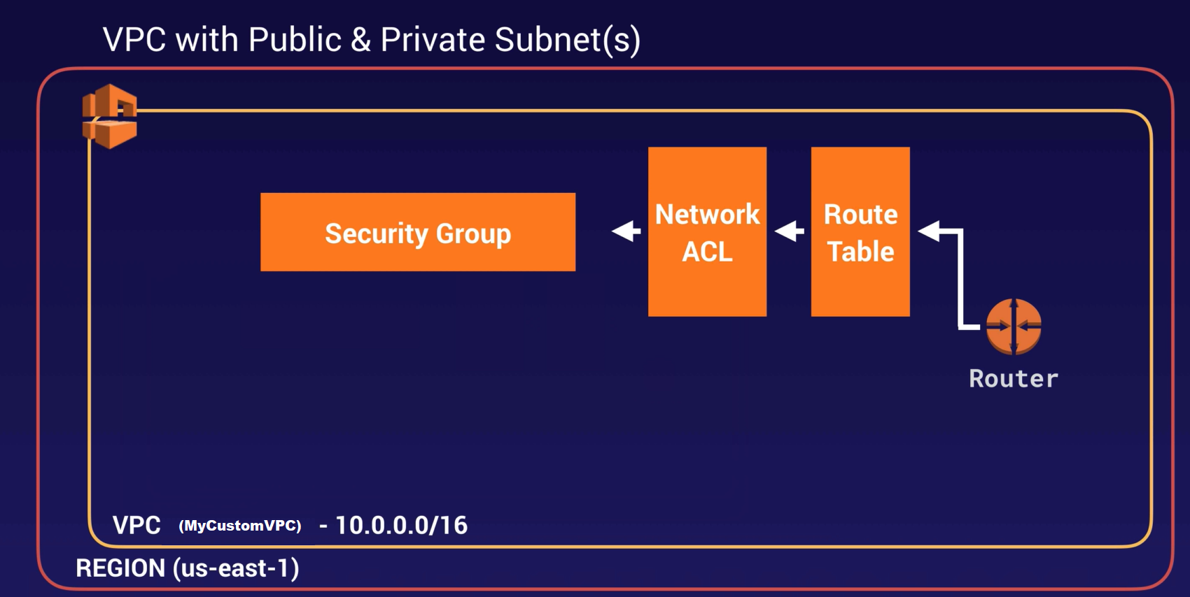
New VPC

Slide 4
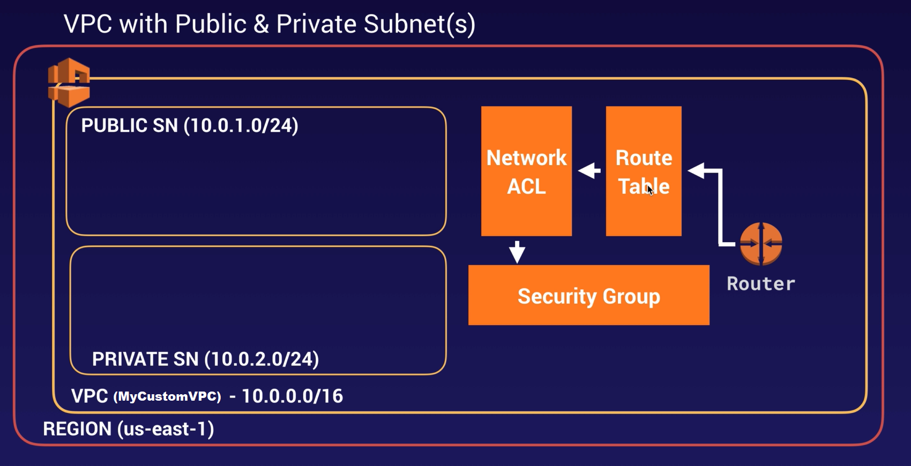
Add subnet to New VPC

Slide 5
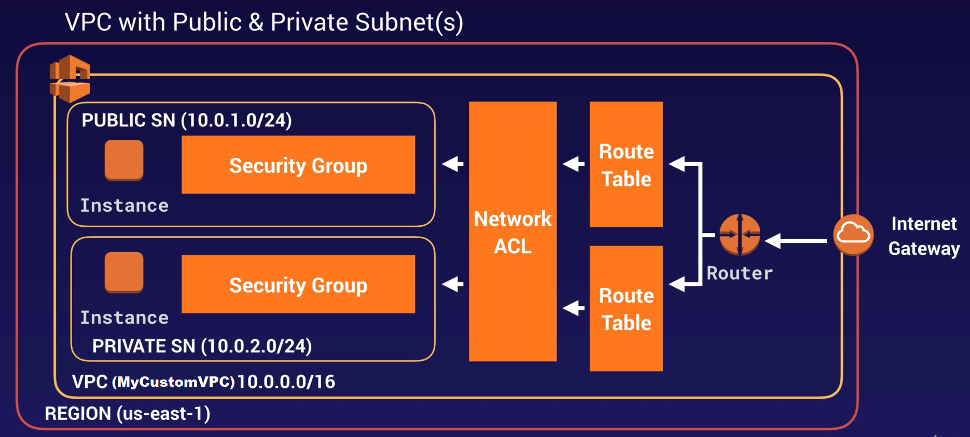
VPC
Public
Main

Slide 6
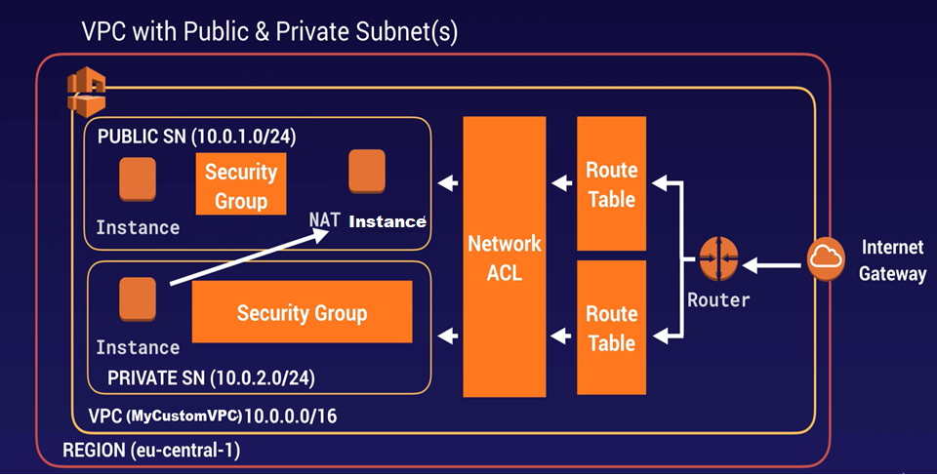
NAT Instance

Slide 7

NAT Gateway

Slide 8
VPC
When You Create a VPC a default Route table, Network Access Control List(NACL) and a default Security Group.
It won't create any subnets, nor will it create a default internet gateway
US-EAST-1A in your AWS account an be a completely different availability zone to US-EAST-1A in another AWS account. The AZs are randomized.
Amazon Always reserve 5 IP addresses within your subnets
You can only have 1 Internet Gateway per VPC
Security Group can't span VPCs
https://docs.aws.amazon.com/vpc/latest/userguide/VPC_NAT_Instance.html

Slide 9
NAT Instance
When Creating a NAT instance, Disable Source/Destination Check on the Instance.
NAT instance must be in a public subnet
There must be a route out of the private subnet to the NAT instance, for this to work
The amount of traffic that NAT instances can support depends on the instance size. If you are bottlenecking, increase the instance size.
You can create high availability using Autoscaling Groups, multiple subnets in different AZs and a script to automate failover
Behind a security Group

Slide 10
NAT Gateway
Redundant inside the Availability Zone
Preferred by the enterprise.
Starts at 5Gbps and scales currently to 45Gbps
No need to patch
Not associated with security groups
Automatically assigned a public IP addresses
Remember to update your route tables
No need to disable Source/Destination Checks

Slide 11
NAT Gateway
If you have resources in multiple Availability Zones and they share one NAT Gateway, if the NAT gateway’s Availability Zone is down, resources in the other Availability Zones lose internet access.
To create an Availability Zone-independent architecture, create a NAT Gateway in each Availability Zone and configure your routing to ensure that resources use the NAT gateway in the same Availability Zone

Slide 12
NACL
Your VPC automatically comes with a default network ACL and by default it allows all inbound and outbound traffic.
You can create custom network ACLs. By default, each custom network ACL denies all inbound and outbound traffic until you add rules
Each subnet in your VPC must be associated with a network ACL.
If you don't explicitly associate a subnet with a network ACL, the subnet is automatically associated with the default network ACL

Slide 13
NACL
Block IP addresses using network ACLs not Security Groups
You can associate a network ACL with multiple subnets; however, a subnet can be associated with only one network ACL at a time.
When you associate a network ACL with a subnet, the previous association is removed
Network ACLs contain a numbered list of rules that is evaluated in order, starting with the lowest numbered rules
Network ACLs have separate inbound and inbound rules and each rules can either allow or deny traffic.
Network ACLs are stateless; responses to allowed inbound traffic are subject to the rules for outbound traffic(and vice-versa)

Slide 14
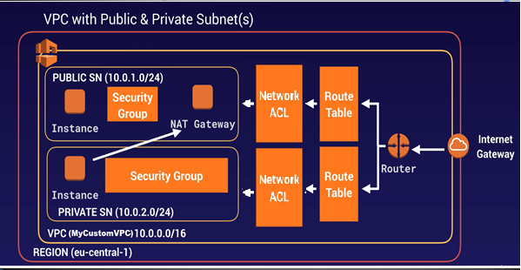
NACL

Slide 15
Flow Logs
You cannot enable flow logs for VPCs that are peered with your VPC unless the peer VPC is in your account
You can tag flow logs
After you've created a flow log, you cannot change its configuration; for example, you can't associate a different IAM role with the flow log
Not all IP traffic is monitored;
Traffic generated by instances when they contact the Amazon DNs server.
If you use your own DNS server, then all traffic to that DNS server is logged
Traffic generated by a Windows instance for Amazon Windows license activation
Traffic to and from 168.254.169.254 for instance metadata
DHCP traffic

Slide 16
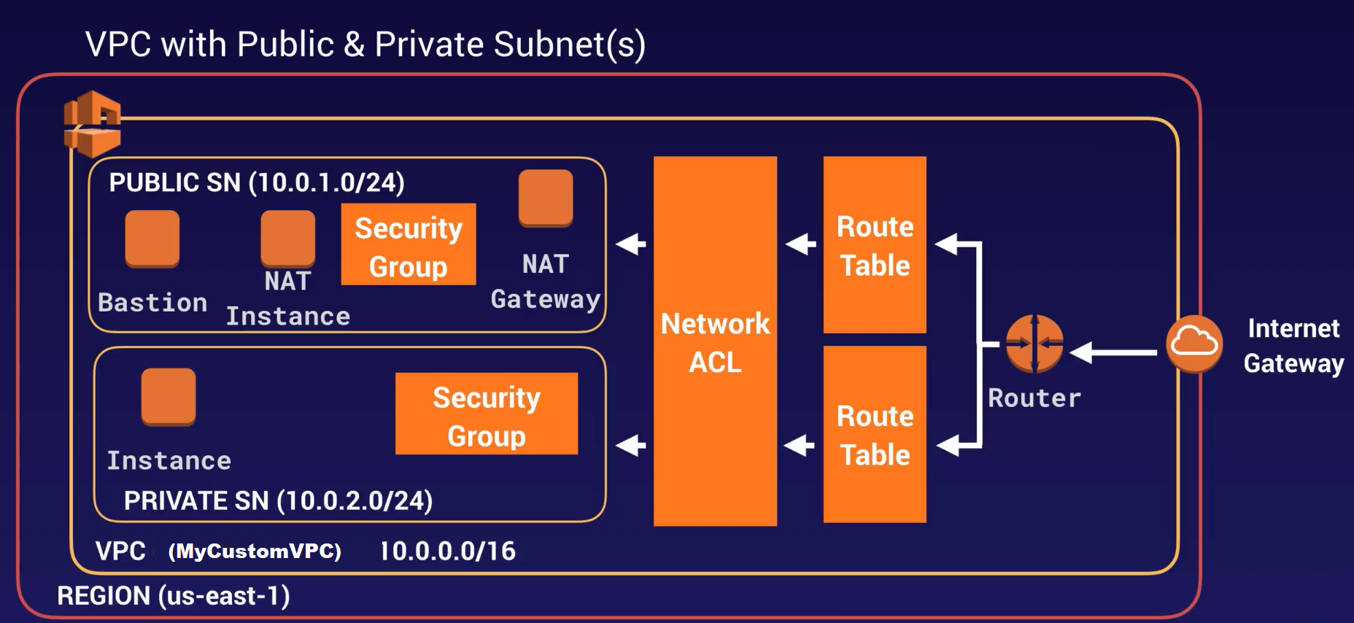
Bastion Host
SSH or RDP

Slide 17
Bastion Host
A NAT Gateway or NAT Instance is used to provide internet traffic to EC2 instances in a private subnets.
A Bastion is used to securely administer EC2 instances (Using SSH or RDP).
Bastion are called Jump Boxes in Australia.
You cannot use a NAT Gateway as a Bastion host

Slide 18
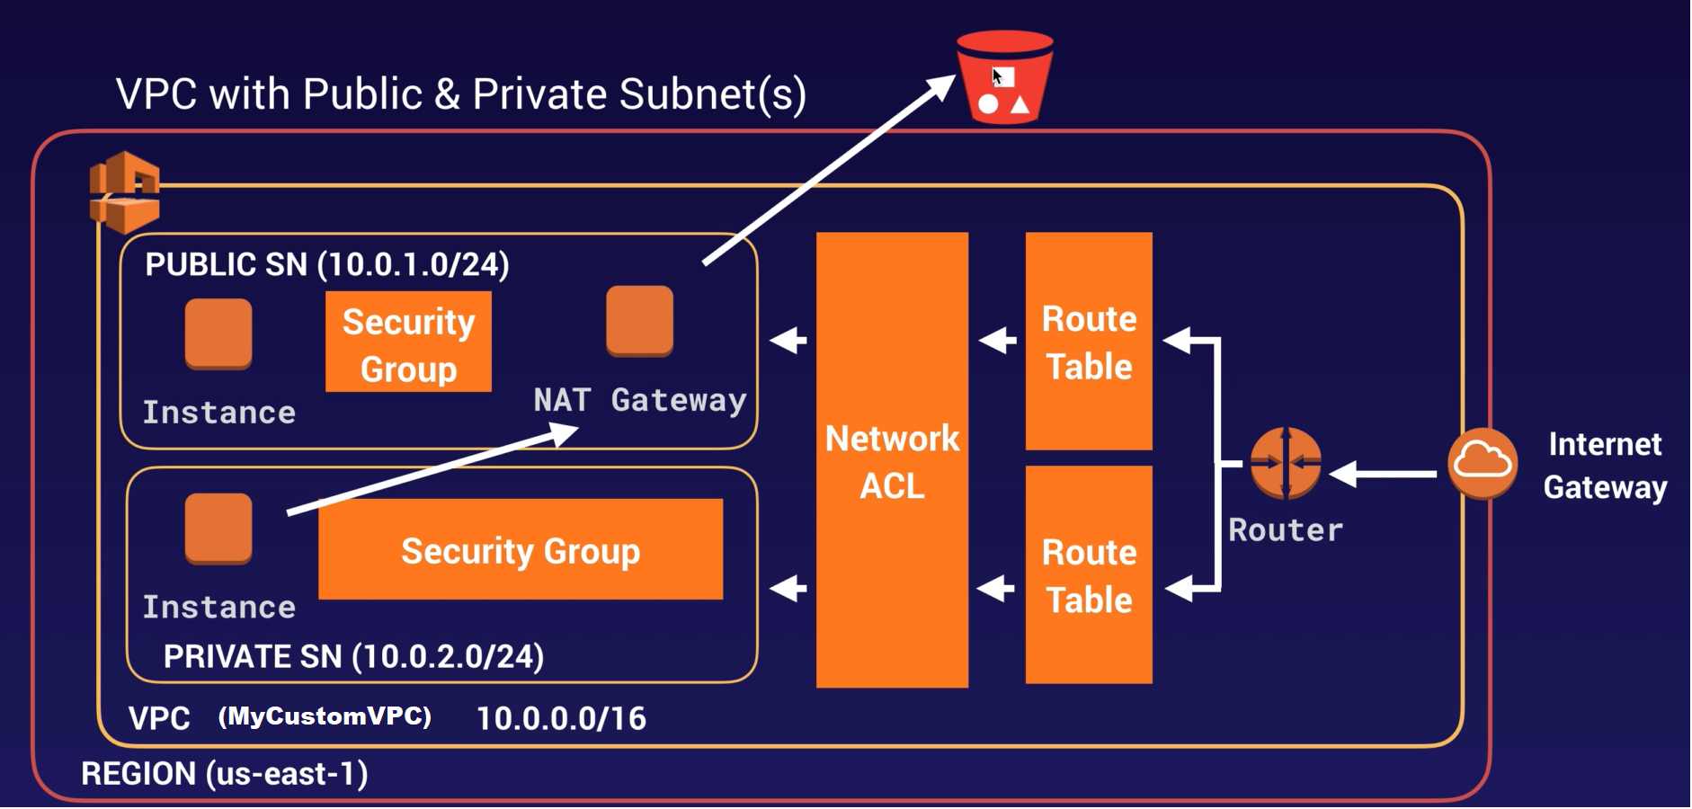
VPC Endpoint

Slide 19
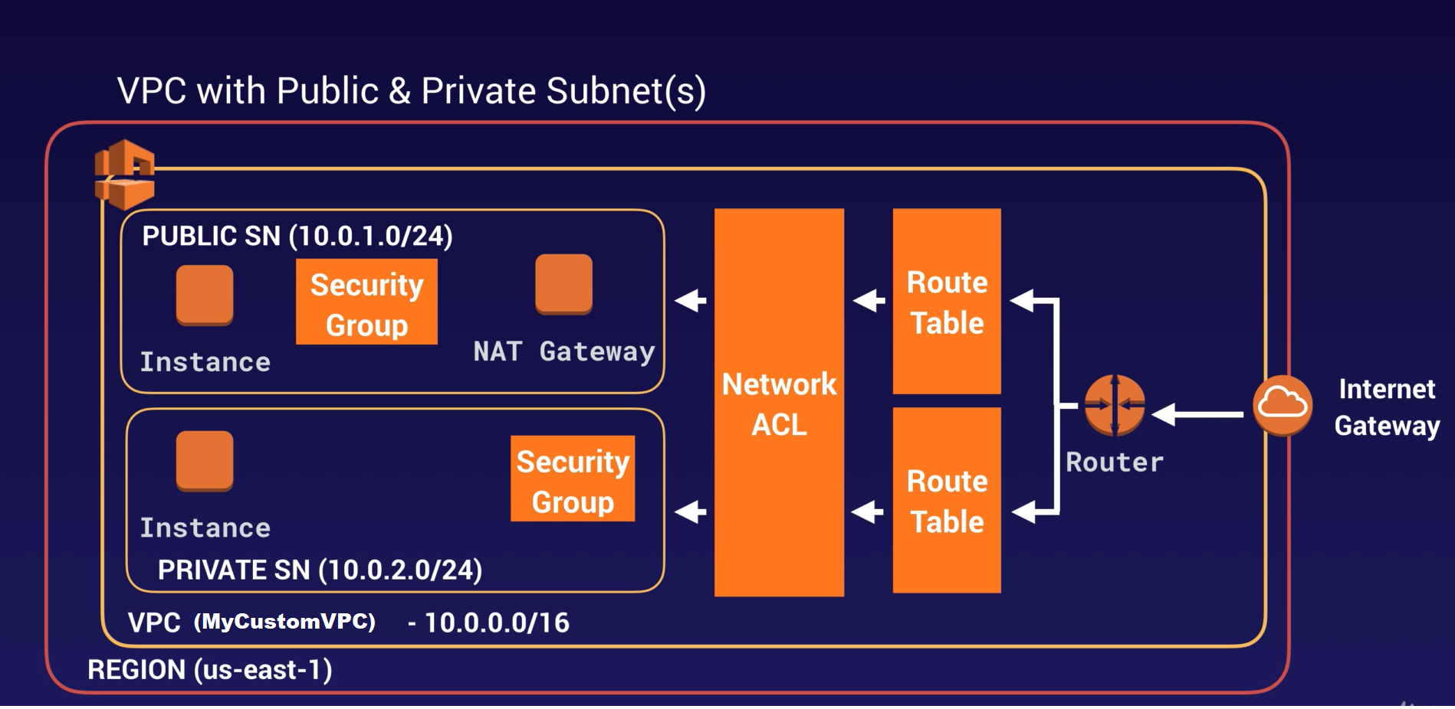


VPC Endpoint
VPC Endpoint

Slide 20
VPC Endpoint
A VPC endpoint enables you to privately connect your VPC to supported AWS services and VPC endpoint services powered by private link without requiring an Internet gateway, a NAT device, a VPN connection or an AWS direct connect connection.
Instances in your VPC do not require public IP addresses to communicate with the resources in the service.
Traffic between your VPC and other services does not leave the Amazon network.
Endpoints are virtual devices. They are horizontally scaled, redundant and highly available VPC components that allow communication between instances in your VPC and services without imposing availability, risk or bandwidth constraints on your network traffic.

Slide 21
Thank you

